Slide 1
Introduction To SQL Class
Billy Rogers
wrogers@austin.rr.com
(512) 297-7474

Slide 2
Introduction to SQL
SQL: Structured Query Language
“Talk” to a database (SQL statements)
Most conversations in daily work
Ask questions
How much money did we make last month
How many books “Wok Cooking” do we have in inventory
Add new data
Add a new customer
Modify existing data
Change a customer’s address
Notes:
What's SQL ?
In 1971, IBM researchers created a simple non-procedural language called Structured English Query Language. or SEQUEL. This was based on Dr. Edgar F. (Ted) Codd's design of a relational model for data storage where he described a universal programming language for accessing databases.
In the late 80's ANSI and ISO (these are two organizations dealing with standards for a wide variety of things) came out with a standardized version called Structured Query Language or SQL. SQL is prounced as 'Sequel'. There have been several versions of SQL and the latest one is SQL-99. Though SQL-92 is the current universally adopted standard.
SQL is the language used to query all databases. It's simple to learn and appears to do very little but is the heart of a successful database application. Understanding SQL and using it efficiently is highly imperative in designing an efficient database application. The better your understanding of SQL the more versatile you'll be in getting information out of databases.
-------
What's an RDBMS ?
This concept was first described around 1970 by Dr. Edgar F. Codd in an IBM research publication called "System R4 Relational".
A relational database uses the concept of linked two-dimensional tables which comprise of rows and columns. A user can draw relationships between multiple tables and present the output as a table again. A user of a relational database need not understand the representation of data in order to retrieve it. Relational programming is non-procedural.
[What's procedural and non-procedural ?
Programming languages are procedural if they use programming elements such as conditional statements (if-then-else, do-while etc.). SQL has none of these types of statements.]
In 1979, Relational Software released the world's first relational database called Oracle V.2
What a DBMS ?
MySQL and mSQL are database management systems or DBMS. These software packages are used to manipulate a database. All DBMSs use their own implementation of SQL. It may be a subset or a superset of the instructions provided by SQL 92.
MySQL, due to it's simplicity uses a subset of SQL 92 (also known as SQL2).
-------
What's Database Normalization ?
Normalization is the process where a database is designed in a way that removes redundancies, and increases the clarity in organizing data in a database.
In easy English, it means take similar stuff out of a collection of data and place them into tables. Keep doing this for each new table recursively and you'll have a Normalized database. From this resultant database you should be able to recreate the data into it's original state if there is a need to do so.
The important thing here is to know when to Normalize and when to be practical. That will come with experience. For now, read on...
Normalization of a database helps in modifying the design at later times and helps in being prepared if a change is required in the database design. Normalization raises the efficiency of the datatabase in terms of management, data storage and scalability.
Now Normalization of a Database is achieved by following a set of rules called 'forms' in creating the database.
-------
-- Stable schema = RDBMS; evolving schema = Hadoop -- Structured data = RDBMS; variably structured data = Hadoop -- ANSI SQL = RDBMS ; flexible programming = Hadoop -- Cleaned data = RDBMS; raw data = Hadoop -- Updates/deletes = RDBMS; ingest = Hadoop -- Core data = RDBMS; all data = Hadoop -- Complex joins = RDBMS; complex processing = Hadoop -- Efficient use of CPU/IO = RDBMS; low-cost storage = Hadoop.
Users interact with database systems through
query languages
. The query lan-
guage of a DBMS has two broad tasks: to define the data structur
es that serve
as receptacles for the data of the database, and to allow the s
peedy retrieval
and modification of data. Accordingly, we distinguish betwe
en two components
of a query language: the
data definition component
and the
data manipulation
component
.
The main tasks of data manipulation are
data retrieval
and
data update
.
Data retrieval entails obtaining data stored in the databas
e that satisfies a
certain specification formulated by the user in a query. Data
updates include
data modification, deletion and insertion.
------
Programming in query languages of DBMSs is done differently f
rom pro-
gramming in higher-level programming languages. The typic
al program written
in C, Pascal, or PL/1 directly implements an algorithm for so
lving a problem.
A query written in a database query language merely states wh
at the problem
is and leaves the construction of the code that solves the pro
blem to a special
component of the DBMS software. This approach to programmin
g is called
nonprocedural
.
A central task of DBMSs is
transaction management
. A
transaction
is a
sequence of database operations (that usually consists of u
pdates, with possible
retrievals) that must be executed in its entirety or not at al
l. This property of
transactions is known as
atomicity
. A typical example includes the transfer of
funds between two account records
A
and
B
in the database of a bank. Such a
banking operation should not modify the total amount of fund
s that the bank
has in its accounts, which is a clear consistency requiremen
t for the database.
The transaction consists of the following sequence of opera
tion

Slide 3
Introduction to SQL
Used as front end to many databases
Oracle
mySQL
PostgreSQL
MS SQL Server
Sybase
BMC: Remedy
95-98% of what you will learn can be used in any database
Notes:
What's SQL ?
In 1971, IBM researchers created a simple non-procedural language called Structured English Query Language. or SEQUEL. This was based on Dr. Edgar F. (Ted) Codd's design of a relational model for data storage where he described a universal programming language for accessing databases.
In the late 80's ANSI and ISO (these are two organizations dealing with standards for a wide variety of things) came out with a standardized version called Structured Query Language or SQL. SQL is prounced as 'Sequel'. There have been several versions of SQL and the latest one is SQL-99. Though SQL-92 is the current universally adopted standard.
SQL is the language used to query all databases. It's simple to learn and appears to do very little but is the heart of a successful database application. Understanding SQL and using it efficiently is highly imperative in designing an efficient database application. The better your understanding of SQL the more versatile you'll be in getting information out of databases.
-------
What's an RDBMS ?
This concept was first described around 1970 by Dr. Edgar F. Codd in an IBM research publication called "System R4 Relational".
A relational database uses the concept of linked two-dimensional tables which comprise of rows and columns. A user can draw relationships between multiple tables and present the output as a table again. A user of a relational database need not understand the representation of data in order to retrieve it. Relational programming is non-procedural.
[What's procedural and non-procedural ?
Programming languages are procedural if they use programming elements such as conditional statements (if-then-else, do-while etc.). SQL has none of these types of statements.]
In 1979, Relational Software released the world's first relational database called Oracle V.2
What a DBMS ?
MySQL and mSQL are database management systems or DBMS. These software packages are used to manipulate a database. All DBMSs use their own implementation of SQL. It may be a subset or a superset of the instructions provided by SQL 92.
MySQL, due to it's simplicity uses a subset of SQL 92 (also known as SQL2).
-------
What's Database Normalization ?
Normalization is the process where a database is designed in a way that removes redundancies, and increases the clarity in organizing data in a database.
In easy English, it means take similar stuff out of a collection of data and place them into tables. Keep doing this for each new table recursively and you'll have a Normalized database. From this resultant database you should be able to recreate the data into it's original state if there is a need to do so.
The important thing here is to know when to Normalize and when to be practical. That will come with experience. For now, read on...
Normalization of a database helps in modifying the design at later times and helps in being prepared if a change is required in the database design. Normalization raises the efficiency of the datatabase in terms of management, data storage and scalability.
Now Normalization of a Database is achieved by following a set of rules called 'forms' in creating the database.
-------
-- Stable schema = RDBMS; evolving schema = Hadoop -- Structured data = RDBMS; variably structured data = Hadoop -- ANSI SQL = RDBMS ; flexible programming = Hadoop -- Cleaned data = RDBMS; raw data = Hadoop -- Updates/deletes = RDBMS; ingest = Hadoop -- Core data = RDBMS; all data = Hadoop -- Complex joins = RDBMS; complex processing = Hadoop -- Efficient use of CPU/IO = RDBMS; low-cost storage = Hadoop.
Users interact with database systems through
query languages
. The query lan-
guage of a DBMS has two broad tasks: to define the data structur
es that serve
as receptacles for the data of the database, and to allow the s
peedy retrieval
and modification of data. Accordingly, we distinguish betwe
en two components
of a query language: the
data definition component
and the
data manipulation
component
.
The main tasks of data manipulation are
data retrieval
and
data update
.
Data retrieval entails obtaining data stored in the databas
e that satisfies a
certain specification formulated by the user in a query. Data
updates include
data modification, deletion and insertion.
------
Programming in query languages of DBMSs is done differently f
rom pro-
gramming in higher-level programming languages. The typic
al program written
in C, Pascal, or PL/1 directly implements an algorithm for so
lving a problem.
A query written in a database query language merely states wh
at the problem
is and leaves the construction of the code that solves the pro
blem to a special
component of the DBMS software. This approach to programmin
g is called
nonprocedural
.
A central task of DBMSs is
transaction management
. A
transaction
is a
sequence of database operations (that usually consists of u
pdates, with possible
retrievals) that must be executed in its entirety or not at al
l. This property of
transactions is known as
atomicity
. A typical example includes the transfer of
funds between two account records
A
and
B
in the database of a bank. Such a
banking operation should not modify the total amount of fund
s that the bank
has in its accounts, which is a clear consistency requiremen
t for the database.
The transaction consists of the following sequence of opera
tion

Slide 4
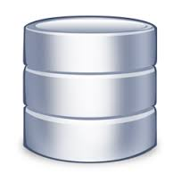
Concepts: Database instance is installed
Database

Slide 5
Schemas are created: Area of DB memory for related data
Ye Corner
Book Store
Schemas
Iwelani
Cruises
Database

Slide 6
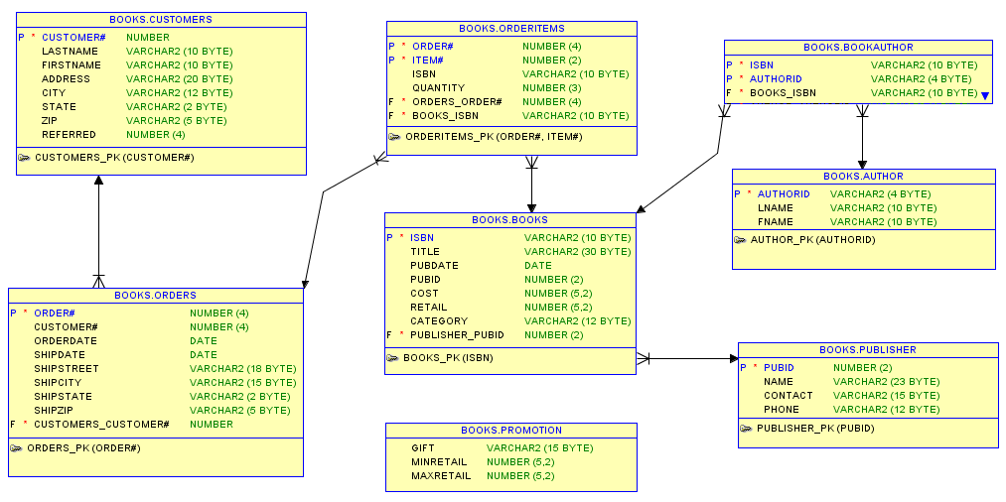
Tables created inside schema to hold data
Ye Corner
Book Store
Iwelani
Cruises
Database

Slide 7
Schemas: Are shown in ER diagrams (Entities/Relationships)

Slide 8
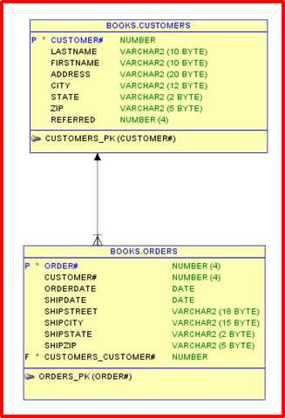
Schemas: ER diagram
Entity:
A thing (think noun) which is independent and can be uniquely identified.
Some thing in the real world which can be distinguished from other things.
Book
Customer
Order

Slide 9
Schemas: ER diagram
Relationship:
Captures how entities are related to one another.
Relationships are like verbs, linking two or more nouns.
One Customer has many orders.
Customer is the parent of the order.

Slide 10
SQL “talking” to a database
Ye Corner
Book Store
Iwelani
Cruises
Oracle Database

Slide 11
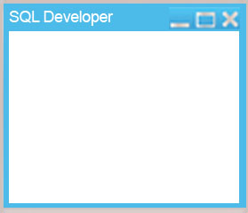
Create connection to database
connection
Ye Corner
Book Store
Books
Iwelani
Cruises
Database

Slide 12
SQL “talking” to a database
Select customer_name
from customers
where last_name = ‘SMITH’;
Ye Corner
Book Store
Iwelani
Cruises
Database

Slide 13
Introduction to SQL
Three kinds of SQL statements
Data description
Tables to hold the data
Data access
Insert, update, delete data
Privileges
Who can access data
The SQL language
Is not case-sensitive for SQL commands
Is case-sensitive when used to ask questions like:
How many “Wok Cooking” books do we have in inventory
How many “WOK COOKING” books do we have in inventory
Notes:
What's SQL ?
In 1971, IBM researchers created a simple non-procedural language called Structured English Query Language. or SEQUEL. This was based on Dr. Edgar F. (Ted) Codd's design of a relational model for data storage where he described a universal programming language for accessing databases.
In the late 80's ANSI and ISO (these are two organizations dealing with standards for a wide variety of things) came out with a standardized version called Structured Query Language or SQL. SQL is prounced as 'Sequel'. There have been several versions of SQL and the latest one is SQL-99. Though SQL-92 is the current universally adopted standard.
SQL is the language used to query all databases. It's simple to learn and appears to do very little but is the heart of a successful database application. Understanding SQL and using it efficiently is highly imperative in designing an efficient database application. The better your understanding of SQL the more versatile you'll be in getting information out of databases.
-------
What's an RDBMS ?
This concept was first described around 1970 by Dr. Edgar F. Codd in an IBM research publication called "System R4 Relational".
A relational database uses the concept of linked two-dimensional tables which comprise of rows and columns. A user can draw relationships between multiple tables and present the output as a table again. A user of a relational database need not understand the representation of data in order to retrieve it. Relational programming is non-procedural.
[What's procedural and non-procedural ?
Programming languages are procedural if they use programming elements such as conditional statements (if-then-else, do-while etc.). SQL has none of these types of statements.]
In 1979, Relational Software released the world's first relational database called Oracle V.2
What a DBMS ?
MySQL and mSQL are database management systems or DBMS. These software packages are used to manipulate a database. All DBMSs use their own implementation of SQL. It may be a subset or a superset of the instructions provided by SQL 92.
MySQL, due to it's simplicity uses a subset of SQL 92 (also known as SQL2).
-------
What's Database Normalization ?
Normalization is the process where a database is designed in a way that removes redundancies, and increases the clarity in organizing data in a database.
In easy English, it means take similar stuff out of a collection of data and place them into tables. Keep doing this for each new table recursively and you'll have a Normalized database. From this resultant database you should be able to recreate the data into it's original state if there is a need to do so.
The important thing here is to know when to Normalize and when to be practical. That will come with experience. For now, read on...
Normalization of a database helps in modifying the design at later times and helps in being prepared if a change is required in the database design. Normalization raises the efficiency of the datatabase in terms of management, data storage and scalability.
Now Normalization of a Database is achieved by following a set of rules called 'forms' in creating the database.
-------
-- Stable schema = RDBMS; evolving schema = Hadoop -- Structured data = RDBMS; variably structured data = Hadoop -- ANSI SQL = RDBMS ; flexible programming = Hadoop -- Cleaned data = RDBMS; raw data = Hadoop -- Updates/deletes = RDBMS; ingest = Hadoop -- Core data = RDBMS; all data = Hadoop -- Complex joins = RDBMS; complex processing = Hadoop -- Efficient use of CPU/IO = RDBMS; low-cost storage = Hadoop.
Users interact with database systems through
query languages
. The query lan-
guage of a DBMS has two broad tasks: to define the data structur
es that serve
as receptacles for the data of the database, and to allow the s
peedy retrieval
and modification of data. Accordingly, we distinguish betwe
en two components
of a query language: the
data definition component
and the
data manipulation
component
.
The main tasks of data manipulation are
data retrieval
and
data update
.
Data retrieval entails obtaining data stored in the databas
e that satisfies a
certain specification formulated by the user in a query. Data
updates include
data modification, deletion and insertion.
------
Programming in query languages of DBMSs is done differently f
rom pro-
gramming in higher-level programming languages. The typic
al program written
in C, Pascal, or PL/1 directly implements an algorithm for so
lving a problem.
A query written in a database query language merely states wh
at the problem
is and leaves the construction of the code that solves the pro
blem to a special
component of the DBMS software. This approach to programmin
g is called
nonprocedural
.
A central task of DBMSs is
transaction management
. A
transaction
is a
sequence of database operations (that usually consists of u
pdates, with possible
retrievals) that must be executed in its entirety or not at al
l. This property of
transactions is known as
atomicity
. A typical example includes the transfer of
funds between two account records
A
and
B
in the database of a bank. Such a
banking operation should not modify the total amount of fund
s that the bank
has in its accounts, which is a clear consistency requiremen
t for the database.
The transaction consists of the following sequence of opera
tion

Slide 14
SQL Class
Text
Roughly one chapter per night
Read before class
Pop Quizzes
Homework
Progress Reports
Exam
Practice at home!

